Slide 1


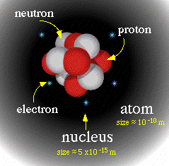
BASIC NUCLEAR
CONCEPTS
Notes:
What is RADAR an acronym for? Radio Detection and Ranging.
Radio wave is generated, transmitted, reflected, and detected.
RADAR unimpaired by night, fog, clouds, smoke.
Not as detailed as actual sight.
RADAR is good for isolated targets against a relatively featureless background.

Slide 2
SEQUENCE
ABOUT NUCLEUS
ATOMIC NO & MASS NO
ATOMIC MASS UNIT & ELECTRON VOLT
NUCLEAR SIZE AND SHAPE
MASS DEFECT & PACKING FRACTION
BINDING ENERGY & NUCLEAR FORCES
PROTON-ELECTRON HYPOTHESIS

Slide 3
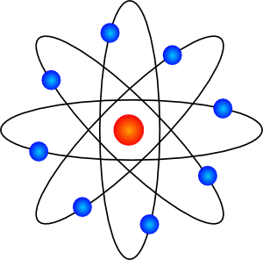
HISTORY
OF
ATOMIC MODEL
Notes:
What is RADAR an acronym for? Radio Detection and Ranging.
Radio wave is generated, transmitted, reflected, and detected.
RADAR unimpaired by night, fog, clouds, smoke.
Not as detailed as actual sight.
RADAR is good for isolated targets against a relatively featureless background.

Slide 4
Constituents of atomic nucleus
All the atomic nuclei are made up of elementary particles called protons and neutrons.
A proton has a positive charge of the same magnitude as that of an electron and mass of proton is
A neutron is electrically neutral and mass of neutron is same as that of proton.
An atomic nucleus is represented by

Slide 5
Constituents of atomic nucleus
Atomic number: The number of protons in a nucleus is called the atomic number. It is denoted by Z.
Mass number: The total number of protons and neutrons in a nucleus is called mass number. It is denoted by A.

Slide 6
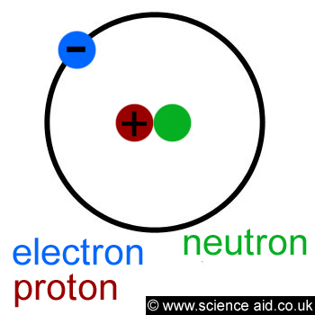
ATOMIC NO & MASS NO
► Atomic number (z) = number of protons or electrons
_{Z}X
► Mass number (A) = number of Nucleons = Protons + Neutrons (Z + N)
X^{A} or ^{A}X
_{Z}X^{A}
A nucleus is expressed as
₆C¹²
₁H¹
Examples :
Notes:
What is RADAR an acronym for? Radio Detection and Ranging.
Radio wave is generated, transmitted, reflected, and detected.
RADAR unimpaired by night, fog, clouds, smoke.
Not as detailed as actual sight.
RADAR is good for isolated targets against a relatively featureless background.

Slide 7
Classification of nucleus
Isotopes: Nuclei having same number of protons but different number of neutrons are called isotopes.
Examples:are isotopes of Hydrogen.
are isotopes of Carbon.

Slide 8
Classification of nucleus
Isobars: Nuclei having same mass number but different atomic number/proton number are called isobars.
Examples: are isobars.
Isotones: Nuclei having same number of neutrons but different atomic number /proton number are called isobars.

Slide 9
ATOMIC MASS UNIT
The common unit of mass and energy in nuclear physics.
(amu)
► It is a unit of mass used to express relative atomic masses. One atomic mass (1 amu) is taken as one-twelfth (1/12) of the mass of carbon atom ₆C¹² and
1 amu = 1.6604 x 10⁻²⁷ kg
► This unit superseded both the physical and chemical mass units based on oxygen – 16.
1 amu (mass) → 931 MeV (energy)
E = mc²
Notes:
What is RADAR an acronym for? Radio Detection and Ranging.
Radio wave is generated, transmitted, reflected, and detected.
RADAR unimpaired by night, fog, clouds, smoke.
Not as detailed as actual sight.
RADAR is good for isolated targets against a relatively featureless background.

Slide 10
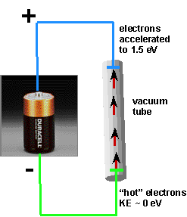
ELECTRON-VOLT
The unit of work and energy in nuclear physics.
► The work done taking an electron through a difference of potential of one volt.
1 electron volt = 1.6 x 10⁻¹⁹ joule
1 MeV = 10⁶ eV
☻ One volt → the p.d. between two pts when one joule of work is done in taking a charge of 1C from one pt to the other pt. Electron charge = 1.6 x 10⁻¹⁹ C
Notes:
What is RADAR an acronym for? Radio Detection and Ranging.
Radio wave is generated, transmitted, reflected, and detected.
RADAR unimpaired by night, fog, clouds, smoke.
Not as detailed as actual sight.
RADAR is good for isolated targets against a relatively featureless background.

Slide 11
ATOMIC NO & MASS NO
► Atomic number (z) = number of protons or electrons
_{Z}X
► Mass number (A) = number of Nucleons = Protons + Neutrons (Z + N)
X^{A} or ^{A}X
_{Z}X^{A}
A nucleus is expressed as
₆C¹²
₁H¹
Examples :
Notes:
What is RADAR an acronym for? Radio Detection and Ranging.
Radio wave is generated, transmitted, reflected, and detected.
RADAR unimpaired by night, fog, clouds, smoke.
Not as detailed as actual sight.
RADAR is good for isolated targets against a relatively featureless background.

Slide 12
ATOMIC MASS UNIT
The common unit of mass and energy in nuclear physics.
(amu)
► It is a unit of mass used to express relative atomic masses. One atomic mass (1 amu) is taken as one-twelfth (1/12) of the mass of carbon atom ₆C¹² and
1 amu = 1.6604 x 10⁻²⁷ kg
► This unit superseded both the physical and chemical mass units based on oxygen – 16.
1 amu (mass) → 931 MeV (energy)
E = mc²
Notes:
What is RADAR an acronym for? Radio Detection and Ranging.
Radio wave is generated, transmitted, reflected, and detected.
RADAR unimpaired by night, fog, clouds, smoke.
Not as detailed as actual sight.
RADAR is good for isolated targets against a relatively featureless background.

Slide 13
ELECTRON-VOLT
The unit of work and energy in nuclear physics.
► The work done taking an electron through a difference of potential of one volt.
1 electron volt = 1.6 x 10⁻¹⁹ joule
1 MeV = 10⁶ eV
☻ One volt → the p.d. between two pts when one joule of work is done in taking a charge of 1C from one pt to the other pt. Electron charge = 1.6 x 10⁻¹⁹ C
Notes:
What is RADAR an acronym for? Radio Detection and Ranging.
Radio wave is generated, transmitted, reflected, and detected.
RADAR unimpaired by night, fog, clouds, smoke.
Not as detailed as actual sight.
RADAR is good for isolated targets against a relatively featureless background.

Slide 14
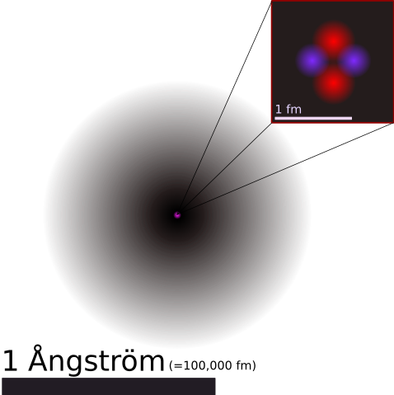
NUCLEAR SIZE & SHAPE
► The nuclei are considered to be very nearly spherical in shape, so the radius of a nucleus defines nuclear size.
► Experimentally,
Volume ∞ mass number or 4/3 π R³ ∞ A or R³ ∞ A or R ∞ A^{1/3}
R = R₀ A^{1/3}
► For H₂ A= 1
So R = 1.4 X 10⁻¹⁵ m
► Where R₀ = constant and its experimental value is 1.4 X 10⁻¹⁵ m
Notes:
What is RADAR an acronym for? Radio Detection and Ranging.
Radio wave is generated, transmitted, reflected, and detected.
RADAR unimpaired by night, fog, clouds, smoke.
Not as detailed as actual sight.
RADAR is good for isolated targets against a relatively featureless background.

Slide 15

NUCLEAR DENSITY
Notes:
What is RADAR an acronym for? Radio Detection and Ranging.
Radio wave is generated, transmitted, reflected, and detected.
RADAR unimpaired by night, fog, clouds, smoke.
Not as detailed as actual sight.
RADAR is good for isolated targets against a relatively featureless background.

Slide 16

NUCLEAR CHARGE
Notes:
What is RADAR an acronym for? Radio Detection and Ranging.
Radio wave is generated, transmitted, reflected, and detected.
RADAR unimpaired by night, fog, clouds, smoke.
Not as detailed as actual sight.
RADAR is good for isolated targets against a relatively featureless background.

Slide 17

The deviation of the atomic mass from the mass number
► A nucleus consists of Z protons and N neutrons. Let the mass of the nucleus be M (Z, N ).
If a nucleus is assumed to be a simple collection of Z protons and N neutrons, the mass of the nucleus would be just the sum of the masses of these constituent nucleons, i.e. , where is the mass of proton and is that of neutron.
Notes:
What is RADAR an acronym for? Radio Detection and Ranging.
Radio wave is generated, transmitted, reflected, and detected.
RADAR unimpaired by night, fog, clouds, smoke.
Not as detailed as actual sight.
RADAR is good for isolated targets against a relatively featureless background.

Slide 18
MASS DEFECT OF NUCLEUS
The deviation of the atomic mass from the mass number
► The actual mass of any permanently stable atom (nucleus) is always less than the sum of the masses of its constituents. This difference of mass is called mass defect (∆M)
► Mathematically, ∆M = Zm_{p} + (A - Z)m_{n} - M
Where, Z = Number of Protons (A - Z) = Number of Neutrons m_{p} = Mass of Proton m_{n} = Mass of Neutron M = Mass of the actual nucleus

Slide 19
PACKING FRACTION
Aston in 1927 expressed the deviation of mass in the form of quantity
► The packing fraction P is the average mass defect or mass defect divided by corresponding mass number
P =
∆M
A
Packing Fraction Curve
P. F →
● P. F is +ve when A < 20 and A > 200
+
o
20
200
● P. F is -ve when A is in between 20 and 200
-
Mass no A →
Notes:
What is RADAR an acronym for? Radio Detection and Ranging.
Radio wave is generated, transmitted, reflected, and detected.
RADAR unimpaired by night, fog, clouds, smoke.
Not as detailed as actual sight.
RADAR is good for isolated targets against a relatively featureless background.

Slide 20
NUCLEAR BINDING ENERGY
B.E is the measure of the stability of the nucleus
► The minimum energy needed to disrupt nucleus into separate neutrons and protons is B.E.
► According to Einstein, the mass defect is converted into B.E by the relation E = mc²
► When a mass equal to 1 amu is converted into energy, then E = ∆M c² where, ∆M = 1.66 x 10⁻²⁷ kg and c = 3 x 10⁸ m/s
E = (1.66 x 10⁻²⁷ kg ) (3 x 10⁸ )² joules
E = 931 MeV
1 eV = 1.6 x 10⁻¹⁹ joule
Notes:
What is RADAR an acronym for? Radio Detection and Ranging.
Radio wave is generated, transmitted, reflected, and detected.
RADAR unimpaired by night, fog, clouds, smoke.
Not as detailed as actual sight.
RADAR is good for isolated targets against a relatively featureless background.

Slide 21
BINDING ENERGY
If the binding energy is large, the nucleus is stable
► If a nucleus is to be broken into its constituent particles, an energy equal to or more than the B.E must be supplied to the nucleus.
Fe⁵⁶
► The greater the B.E per nucleon, the more stable the nucleus is. F⁵⁶ is the most stable nucleus in the nature.
B.E per nucleon
B.E → 8.8 MeV/nucleon
Mass no
Notes:
What is RADAR an acronym for? Radio Detection and Ranging.
Radio wave is generated, transmitted, reflected, and detected.
RADAR unimpaired by night, fog, clouds, smoke.
Not as detailed as actual sight.
RADAR is good for isolated targets against a relatively featureless background.

Slide 22

The binding energy per nucleon for a given nucleus is found by dividing its total binding energy by the number of nucleons (protons and neutrons) it contains.
Accordingly, the binding energy per nucleon for deuterium nucleus is 2.22 MeV/2 =1.11 MeV and for bismuth it is 1640 MeV/209 = 7.8 MeV/ nucleon.
Notes:
What is RADAR an acronym for? Radio Detection and Ranging.
Radio wave is generated, transmitted, reflected, and detected.
RADAR unimpaired by night, fog, clouds, smoke.
Not as detailed as actual sight.
RADAR is good for isolated targets against a relatively featureless background.

Slide 23


PROBLEMS
WHY THE MUTUAL REPULSION OF THE PROTONS DOES NOT DISINTEGRATE THE NUCLEUS
Notes:
What is RADAR an acronym for? Radio Detection and Ranging.
Radio wave is generated, transmitted, reflected, and detected.
RADAR unimpaired by night, fog, clouds, smoke.
Not as detailed as actual sight.
RADAR is good for isolated targets against a relatively featureless background.

Slide 24

PROBLEMS
WHY THE MUTUAL REPULSION OF THE PROTONS DOES NOT DISINTEGRATE THE NUCLEUS
Notes:
What is RADAR an acronym for? Radio Detection and Ranging.
Radio wave is generated, transmitted, reflected, and detected.
RADAR unimpaired by night, fog, clouds, smoke.
Not as detailed as actual sight.
RADAR is good for isolated targets against a relatively featureless background.

Slide 25

PROBLEMS
WHY THE MUTUAL REPULSION OF THE PROTONS DOES NOT DISINTEGRATE THE NUCLEUS
Notes:
What is RADAR an acronym for? Radio Detection and Ranging.
Radio wave is generated, transmitted, reflected, and detected.
RADAR unimpaired by night, fog, clouds, smoke.
Not as detailed as actual sight.
RADAR is good for isolated targets against a relatively featureless background.

Slide 26

PROBLEMS
WHY THE MUTUAL REPULSION OF THE PROTONS DOES NOT DISINTEGRATE THE NUCLEUS
Notes:
What is RADAR an acronym for? Radio Detection and Ranging.
Radio wave is generated, transmitted, reflected, and detected.
RADAR unimpaired by night, fog, clouds, smoke.
Not as detailed as actual sight.
RADAR is good for isolated targets against a relatively featureless background.

Slide 27

PROBLEMS
Notes:
What is RADAR an acronym for? Radio Detection and Ranging.
Radio wave is generated, transmitted, reflected, and detected.
RADAR unimpaired by night, fog, clouds, smoke.
Not as detailed as actual sight.
RADAR is good for isolated targets against a relatively featureless background.

Slide 28

PROBLEMS
Notes:
What is RADAR an acronym for? Radio Detection and Ranging.
Radio wave is generated, transmitted, reflected, and detected.
RADAR unimpaired by night, fog, clouds, smoke.
Not as detailed as actual sight.
RADAR is good for isolated targets against a relatively featureless background.

Slide 29

PROBLEMS
Notes:
What is RADAR an acronym for? Radio Detection and Ranging.
Radio wave is generated, transmitted, reflected, and detected.
RADAR unimpaired by night, fog, clouds, smoke.
Not as detailed as actual sight.
RADAR is good for isolated targets against a relatively featureless background.

Slide 30

PROBLEMS
Notes:
What is RADAR an acronym for? Radio Detection and Ranging.
Radio wave is generated, transmitted, reflected, and detected.
RADAR unimpaired by night, fog, clouds, smoke.
Not as detailed as actual sight.
RADAR is good for isolated targets against a relatively featureless background.

Slide 31

PROBLEMS
Notes:
What is RADAR an acronym for? Radio Detection and Ranging.
Radio wave is generated, transmitted, reflected, and detected.
RADAR unimpaired by night, fog, clouds, smoke.
Not as detailed as actual sight.
RADAR is good for isolated targets against a relatively featureless background.

Slide 32
THANK YOU
Notes:
What is RADAR an acronym for? Radio Detection and Ranging.
Radio wave is generated, transmitted, reflected, and detected.
RADAR unimpaired by night, fog, clouds, smoke.
Not as detailed as actual sight.
RADAR is good for isolated targets against a relatively featureless background.

Slide 33
Rutherford’s Gold Foil Experiment
Radius of nucleus is 10⁻¹² to 10⁻¹³ cm
THIS EXPT SHOWED
TWO THINGS
DO NOT OPEN
RADIOACTIVE
MATERIAL
INSIDE
Passing α-particle (+)
Nucleus must be +
+
+
+
+
+
+
+
+
+
+
+
+
+
+
+
+
+
+
+
+
+
+
+
+
+
+
+
+
+
+
+
+
+
+
+
+
+
+
+
+
+
+
+
+
+
+
+
+
+
+
+
+
+
+
+
+
+
+
+
+
+
+

Slide 34
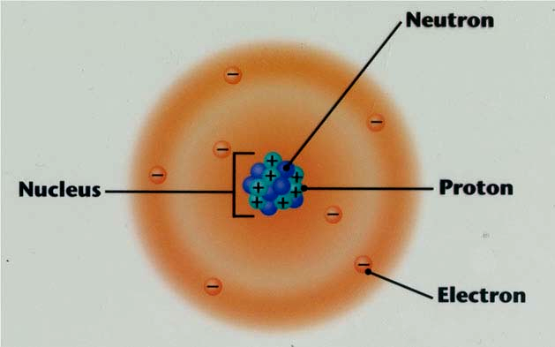
Rutherford’s Model
An atom consists of a small nucleus containing all the positive charges of the atom and practically the whole of its mass.
The nucleus is surrounded by a number of electrons equal to the number of positive charges on the nucleus.

Slide 35
The electrons are in constant motion round the nucleus like that of planets round the sun in such a way that the electrostatic force of attraction between the electrons and positive nucleus is counterbalanced by the centrifugal force.
The unit of positive charge in an atom is considered to be due to proton. Here it can be assumed that a nucleus consists of protons which provide all the positive charges and probably almost all the mass of the atom.

Slide 36

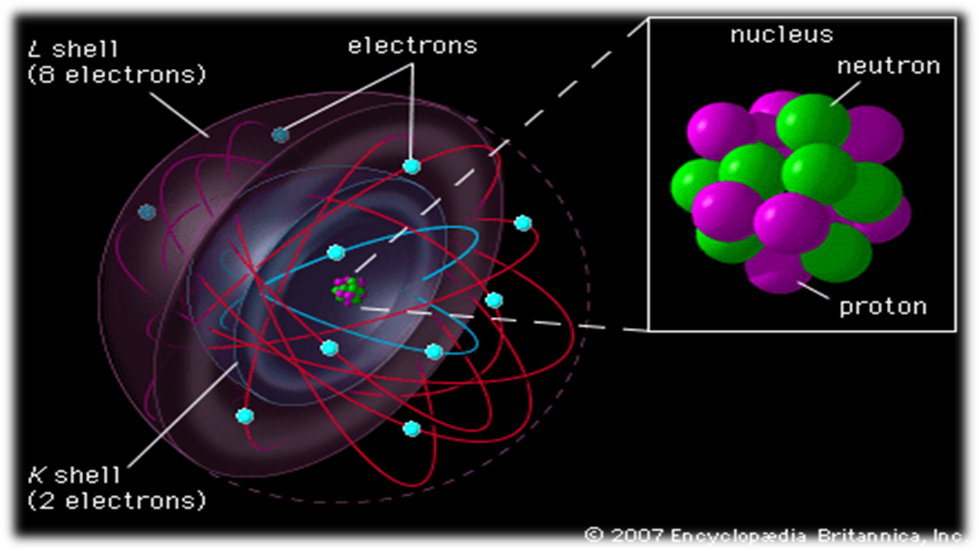
BOHR'S ATOM MODEL
Positively charged nucleus are at the centre and negatively charged electrons revolve round the nucleus in various circular orbit.

Slide 37
Bohr pointed out that the Rutherford atom model is extremely unstable for the following reasons:
Newton’s Laws of motion and gravitation can only be applied to neutral bodies such as planets and not to charged bodies such as tiny electrons moving round a positive nucleus.
According to Maxwell’ theory, any charged body such as electrons rotating in an orbit must radiate energy continuously thereby losing kinetic energy. Hence the electron must gradually spiral in towards the nucleus.

Slide 38
In order to overcome these difficulties Bohr made some revolutionary suggestions in an attempt to arrive at a solution.
He succeeded to some extent in correlating the empirical knowledge of atomic spectra and Planck’s theory of radiation.
According to Planck’s theory of radiation, energy is radiated or absorbed by a body discontinuously in a define fundamental unit or in an integral multiple of the fundamental unit. This unit of energy was called by Planck “a quantum”.

Slide 39
The magnitude of the unit of energy depends upon the frequency of radiation and thus a quantum of energy is directly proportional to the frequency of the radiation υ.
In equation form this is expressed as,
E ∝ υ
Or, E = hυ
This quantum of energy is known as photon resulting from one electronic transition.
E is the unit of energy and h, the Planck’s constant

Slide 40
Bohr’s Atom Model
Bohr constructed a theory of hydrogen atom in particular and to some extent of atomic structure in general. Bohr’s theory consists of the following postulates:
Postulate of Energy Levels.
An atom has a number of stable orbits in which an electron can revolve without the radiation of energy.
These orbits are referred to as “Energy Levels". The electrons in these orbits possess an integral multiple of the quantum of energy hυ, but do not radiate it.

Slide 41

If the electron moves in a circular orbit, its motion is subject to the ordinary laws of electrical and centrifugal forces.
These orbits are decided by the condition that the angular momentum of the electron in such orbits must be an integral multiple of h/2π, so the angular momentum of the electron is mvr= nh/2π.
Where m is the mass of the electron, v is its velocity, r is the radius of the orbit and n is 1, 2, 3, 4, 5 etc. (h is the plank’s constant)

Slide 42
Postulate of Frequency of radiation.
An atom radiates energy as light only when an electron passes from higher energy level to another of lower energy giving definite spectral lines in emission spectra.
The quantity of energy radiated or absorbed is equal to the difference between the energies the atom possessed before and after the elctron changed orbits.

